Slide 1
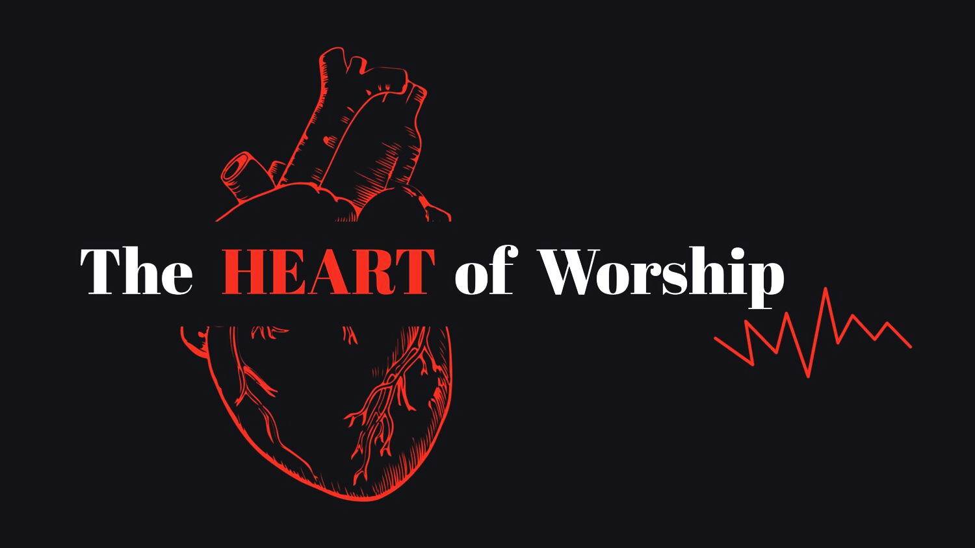
The HEART of Worship
Notes:
1

Slide 2
Genesis 4, page 3
Leviticus 10 page 67
2 Samuel 6, page 194
Malachi 1, page 611
Matthew 23, page 633.
Notes:
2

Slide 3
The HEART of Worship
What is Worship?
Notes:
3

Slide 4
Worship is choosing to enthusiastically and correctly respond to who God is and what He says, with all I am – my thoughts, desires, and attitudes – all I say, all I do, all I have and all I control.
Notes:
4

Slide 5
I will praise You, O Lord,
with my whole heart; I will tell of all Your marvelous works.
I will be glad and rejoice in You; I will sing praise to
Your name, O Most High.
Psalm 9:1-2
Notes:
5

Slide 7
The HEART of Worship
What is Wrong Worship?
Notes:
7

Slide 8
For whatever things were written before were written for our learning … Romans 15:4
Notes:
8

Slide 10
Search me, O God, and know my heart: try me, and know my thoughts: And see if there be any wicked way in me ... Psalms 139:23-24
Notes:
10

Slide 11
One who is wise is cautious and turns away from evil, but a fool is reckless and careless. Proverbs 14:16 esv
Notes:
11

Slide 12
Wrong Worship …
is Self Centered.

Slide 14
Everyone worships something. The only choices we get are who or what we worship and how we worship.
~adapted from Tim Keller

Slide 18
Wrong Worship …
is Self Centered.
is Unbiblical.

Slide 20
We must seek above all to do what pleases Him. To do this, we cannot trust our own imaginations. Nadab and Abihu trusted their own wisdom and God judged them severely. Can any of us trust ourselves to determine apart from Scripture, what God does and does not like in worship? Our finitude and sin disqualifies us from making such judgments … we must seek God’s own wisdom, the revelation of His own heart. We must ask the Scriptures what God wants us to do in worship. Then, as we worship, we must do those things. ~John Frame
Notes:
20

Slide 21
Wrong Worship …
is Self Centered.
is Unbiblical.
Ignores God’s Word.

Slide 23
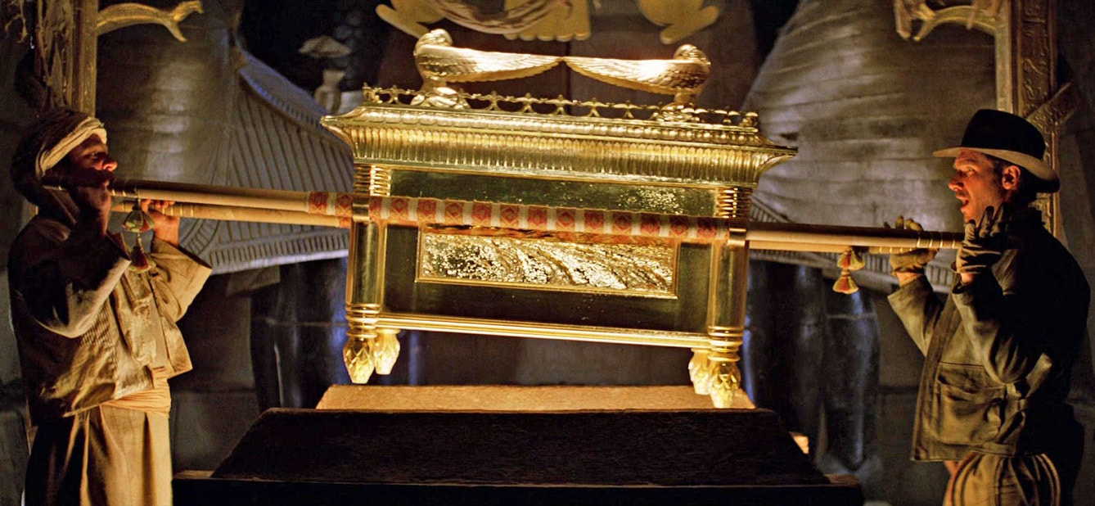

Slide 24
Wrong Worship …
is Self Centered.
is Unbiblical.
Ignores God’s Word.
is Nonchalant.

Slide 25
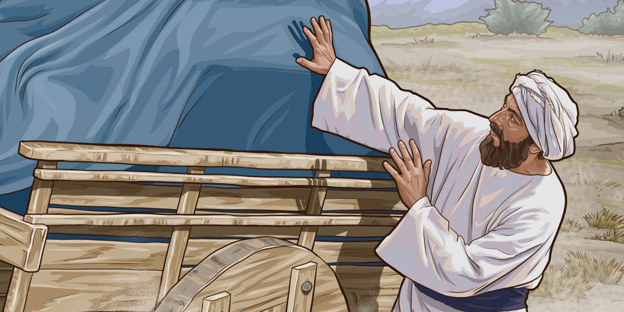

Slide 26
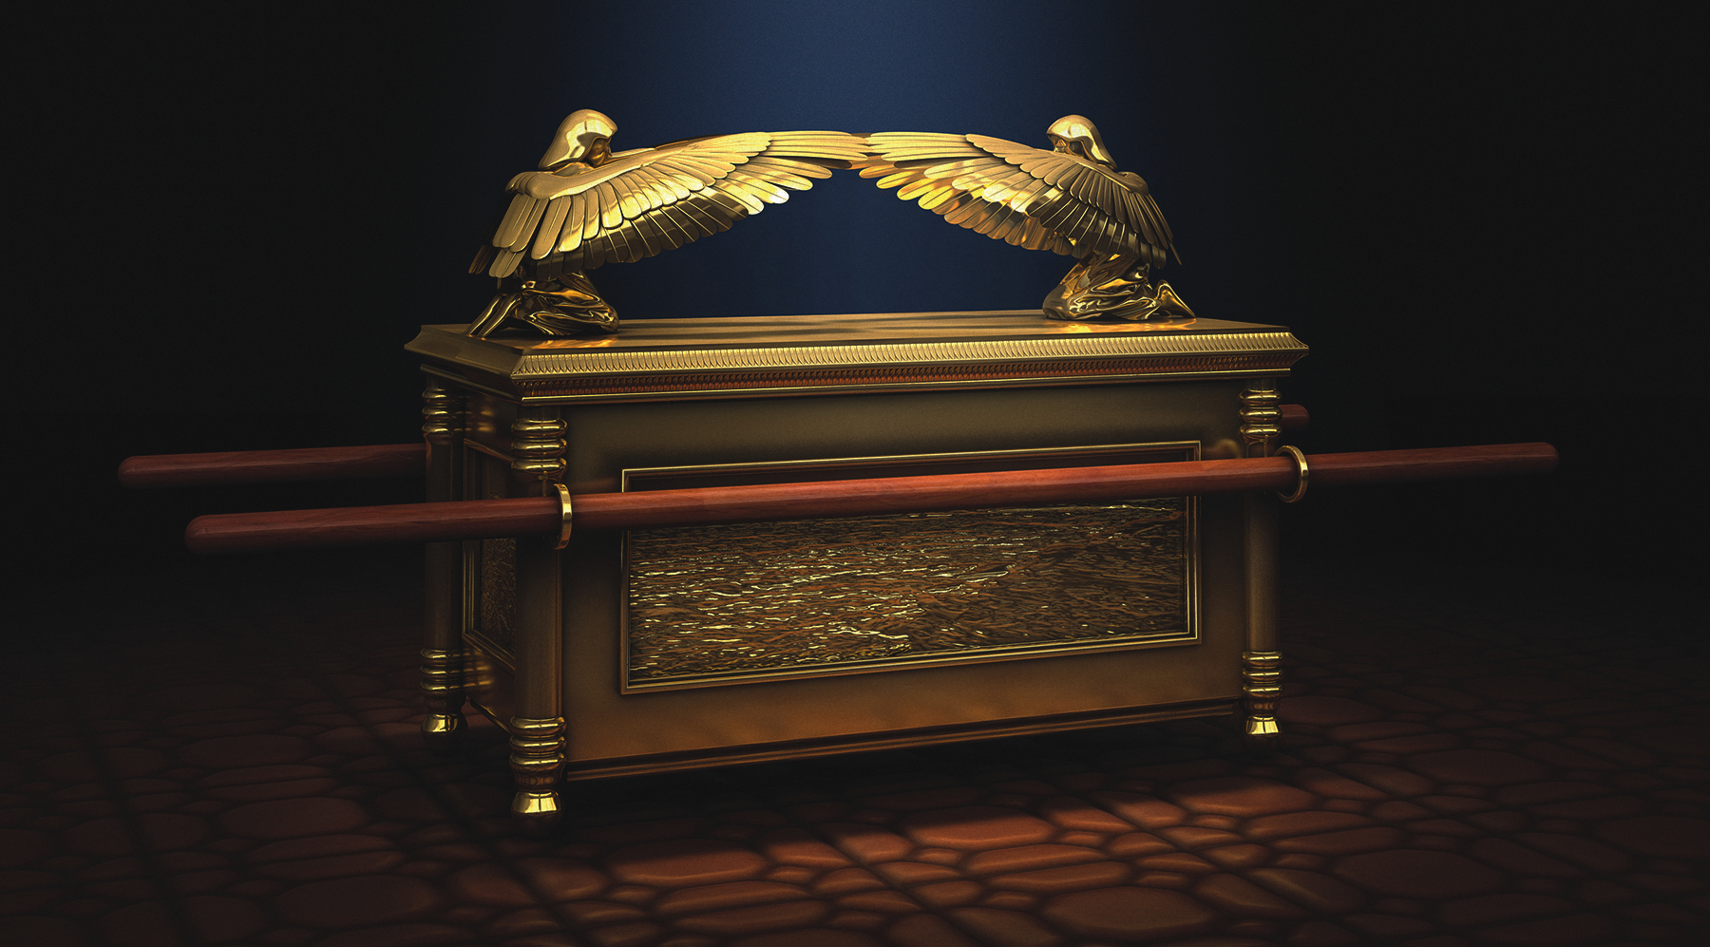

Slide 28
… we may offer to God an acceptable service with reverence and awe; for our God is a consuming fire. Hebrews 12:27-28 esv
Notes:
28

Slide 29
It is a matter of utmost importance, literally a life and death matter, to know how to worship God rightly, according to His will. The wrong kind of worship provokes God's wrath not His blessing. We may not do anything we please in God's awesome presence. [We] are far too casual about worship. … Meetings with God in the Bible are awesome and terrible. … Perhaps we should be satisfied, even thankful, that our meetings with God today are less direct (though just as real …). Surely we can be thankful that we stand before God in Christ, who bore the fearsome wrath of God in our place. ~John Frame
Notes:
29

Slide 30
Wrong Worship is …
Judgmental.

Slide 31
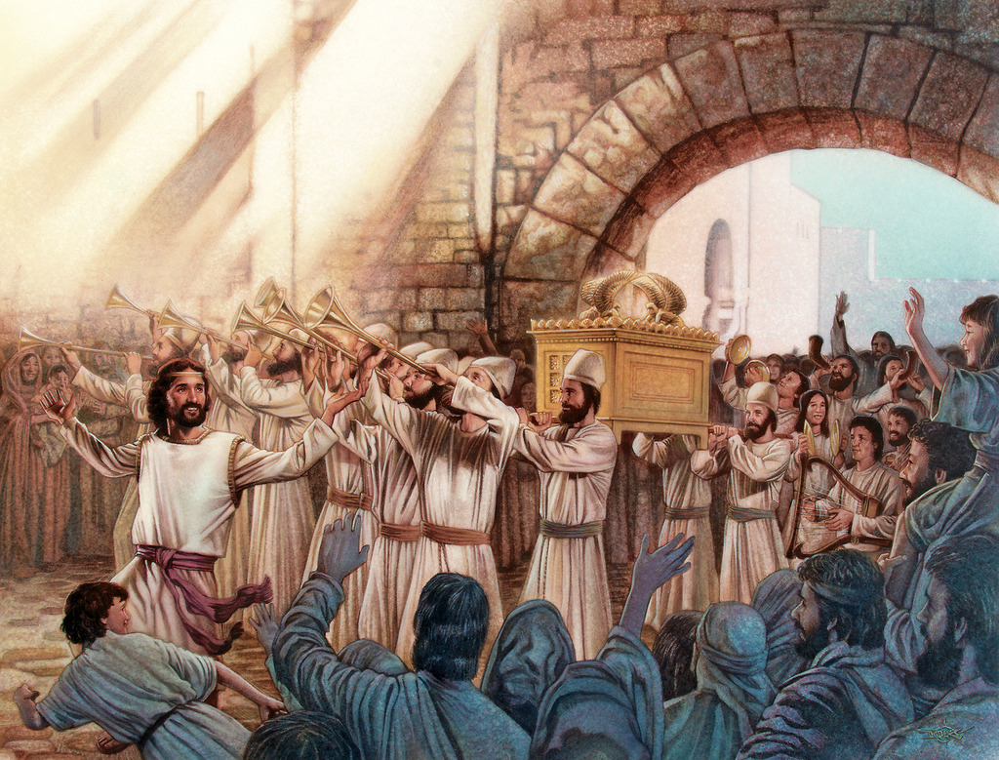

Slide 34
Wrong Worship is …
Judgmental.
Selfish.

Slide 35
The Old Testament perspective on all wealth is that the best and first of it never has belonged to its temporary human controller (“owner”), but always has belonged to God.
~Douglas Stuart
Notes:
35

Slide 36
This is For God

Slide 37
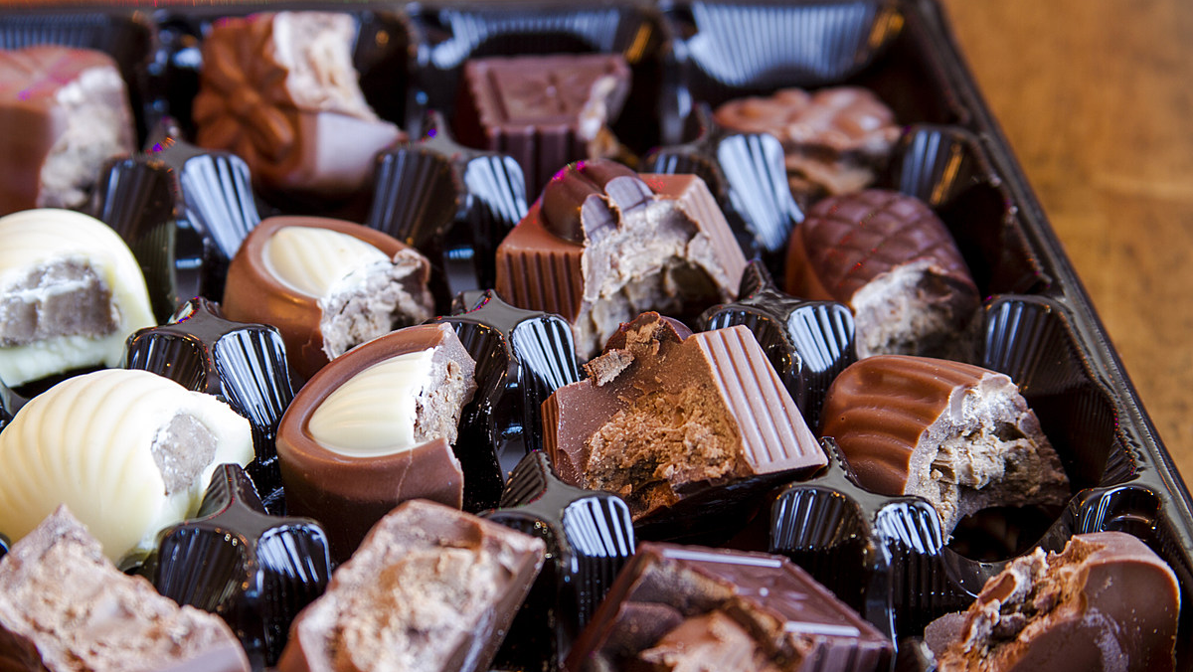

Slide 39
Wrong Worship is …
Judgmental.
Selfish.
Legalistic.

Slide 40
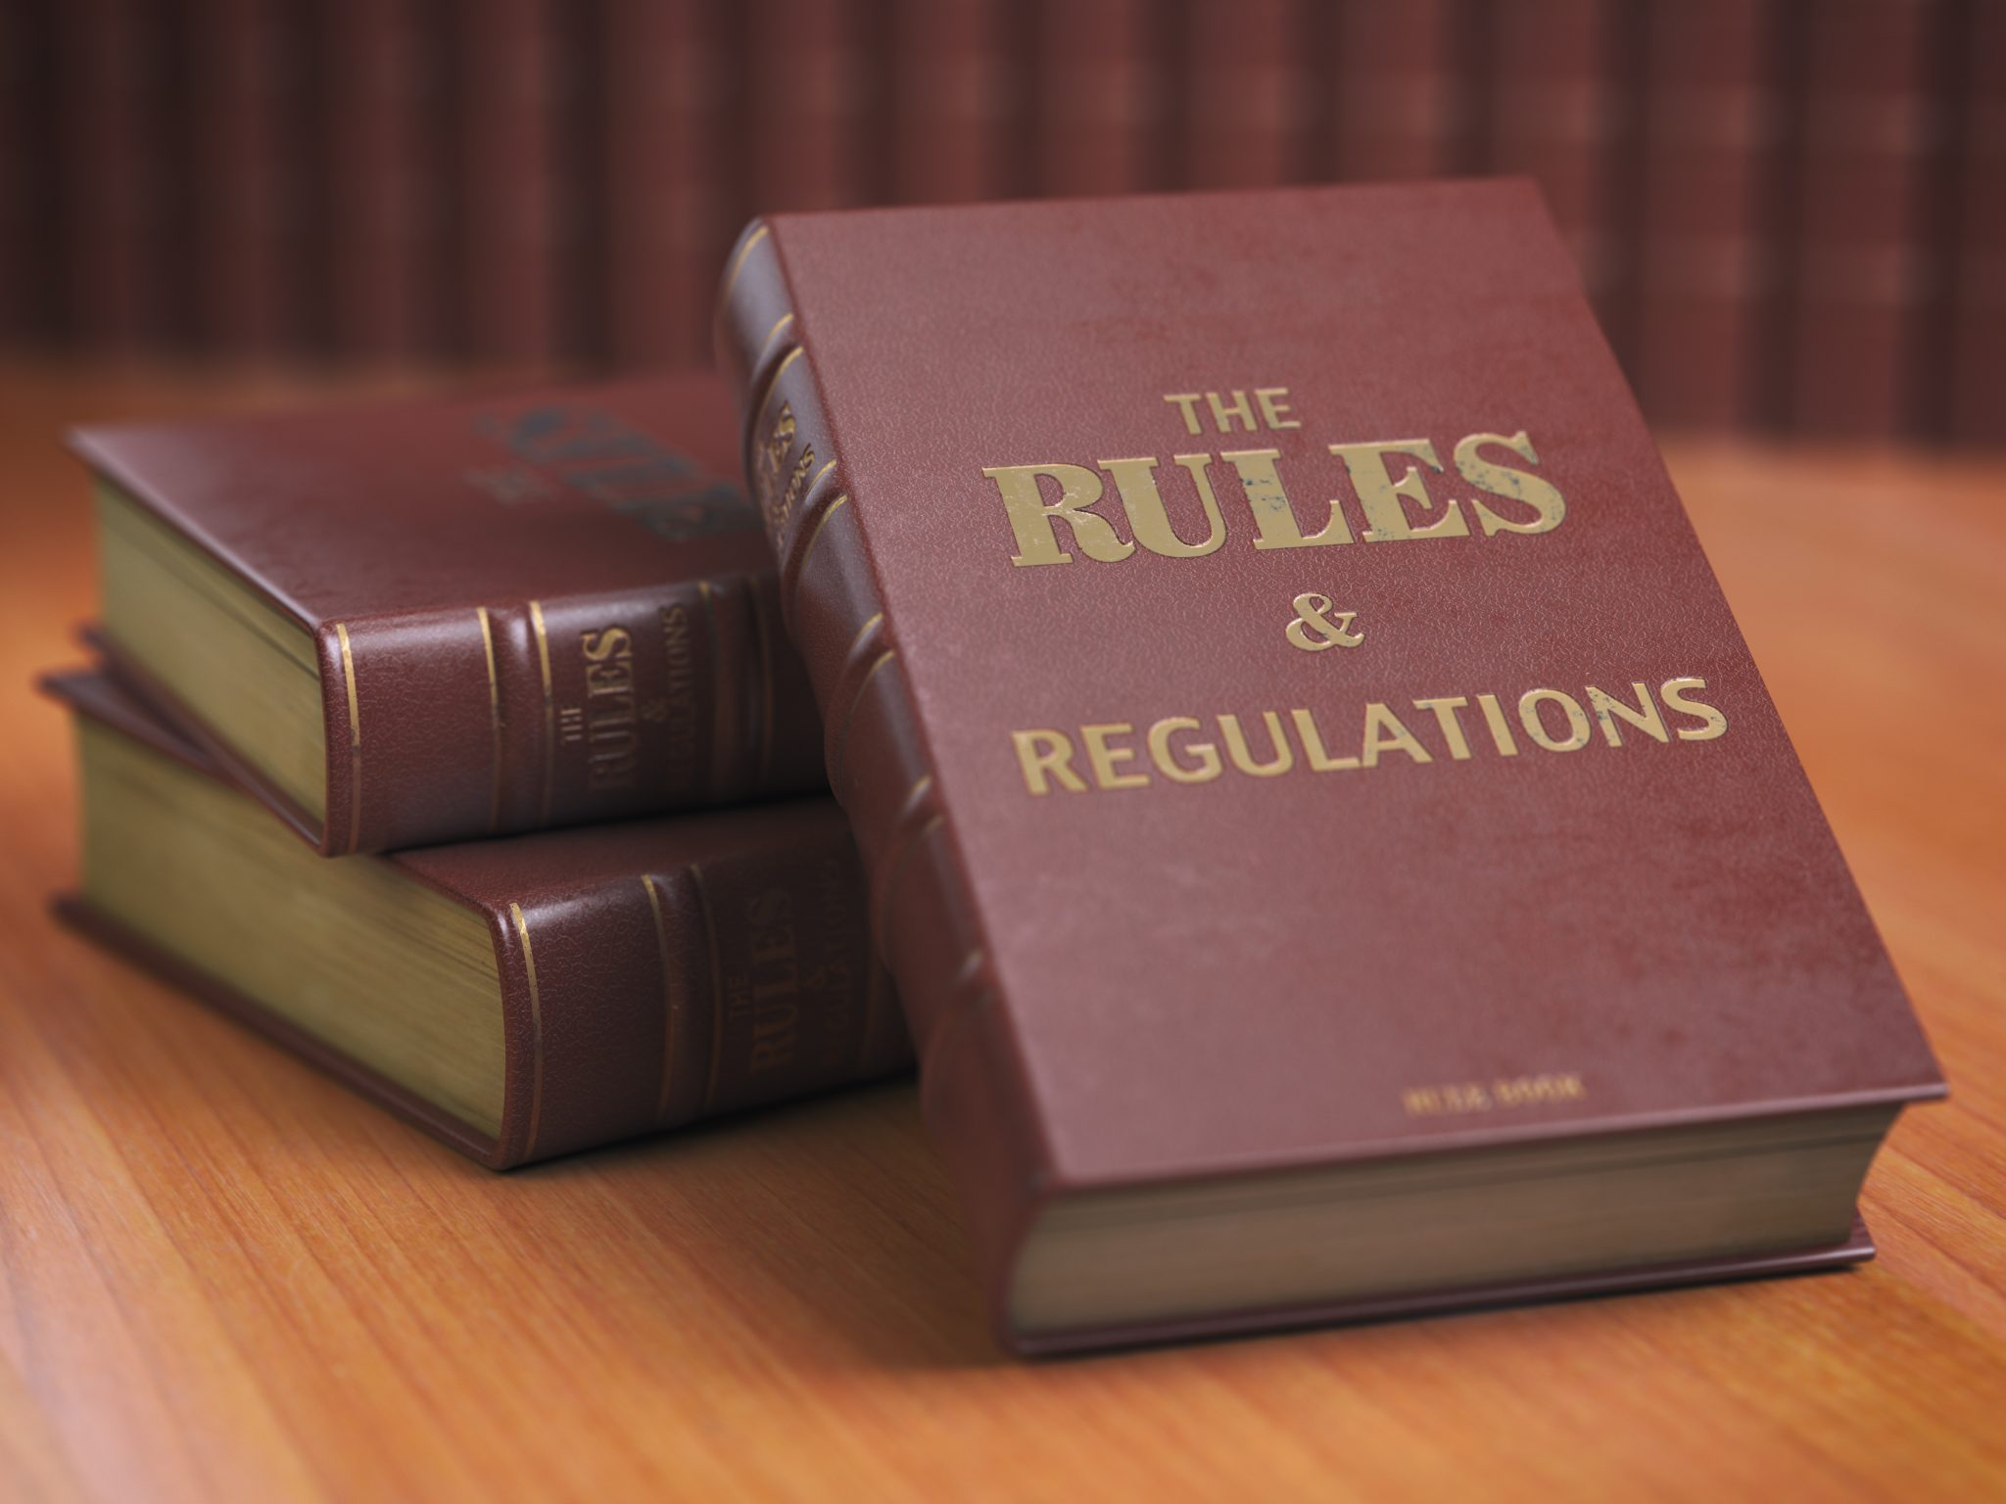

Slide 41
You shall love the Lord your God with all your heart, with all your soul, and with all your strength. And these words which I command you today shall be in your heart.
Deuteronomy 6:5-6
Notes:
41

Slide 42
Many times, people want to take their opinions … and make that the test of spirituality for everyone.
This is legalistic.
~Steve Viars
Notes:
42

Slide 43
The HEART of Worship
What is Wrong Worship?
Notes:
43

Slide 45
προσκυνέω
pros-ku-ne-o
worship
Notes:
45

Slide 48
